Slide 1
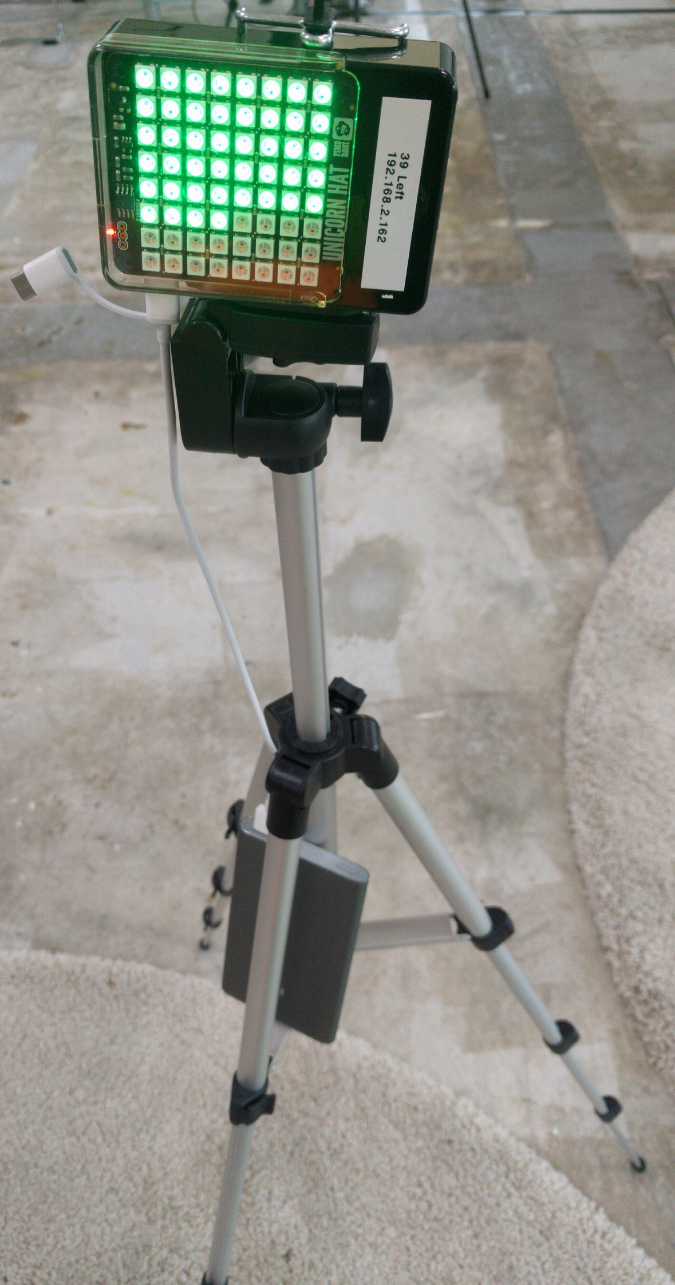
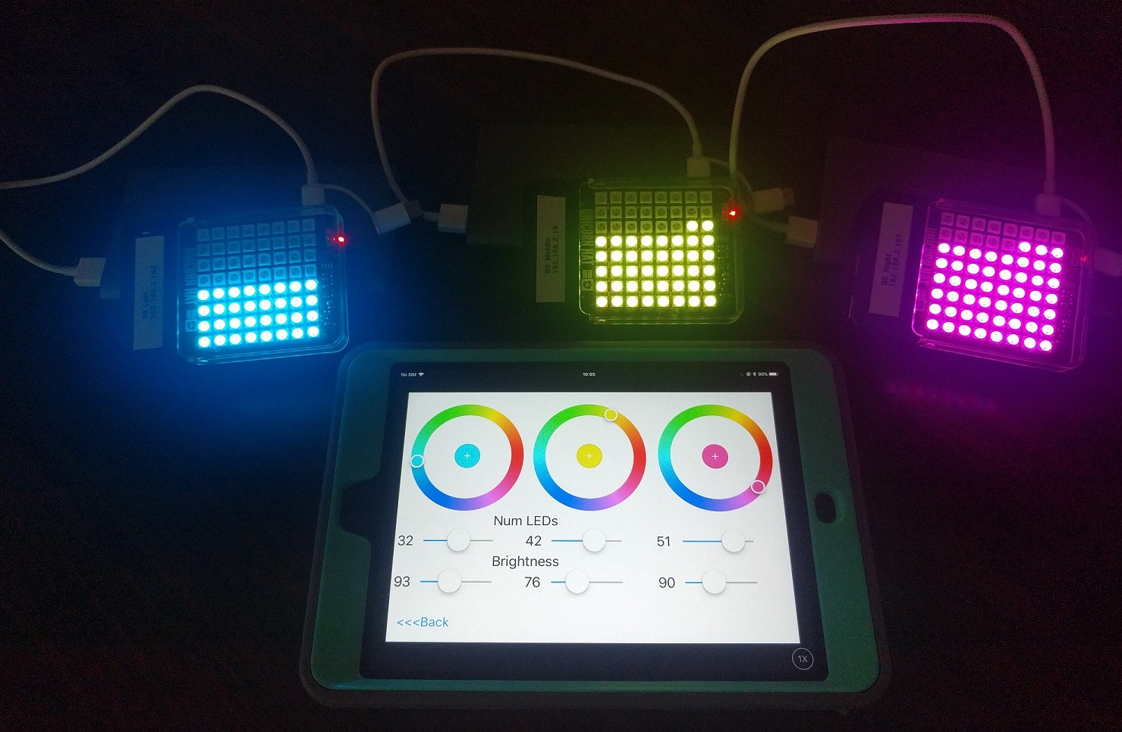
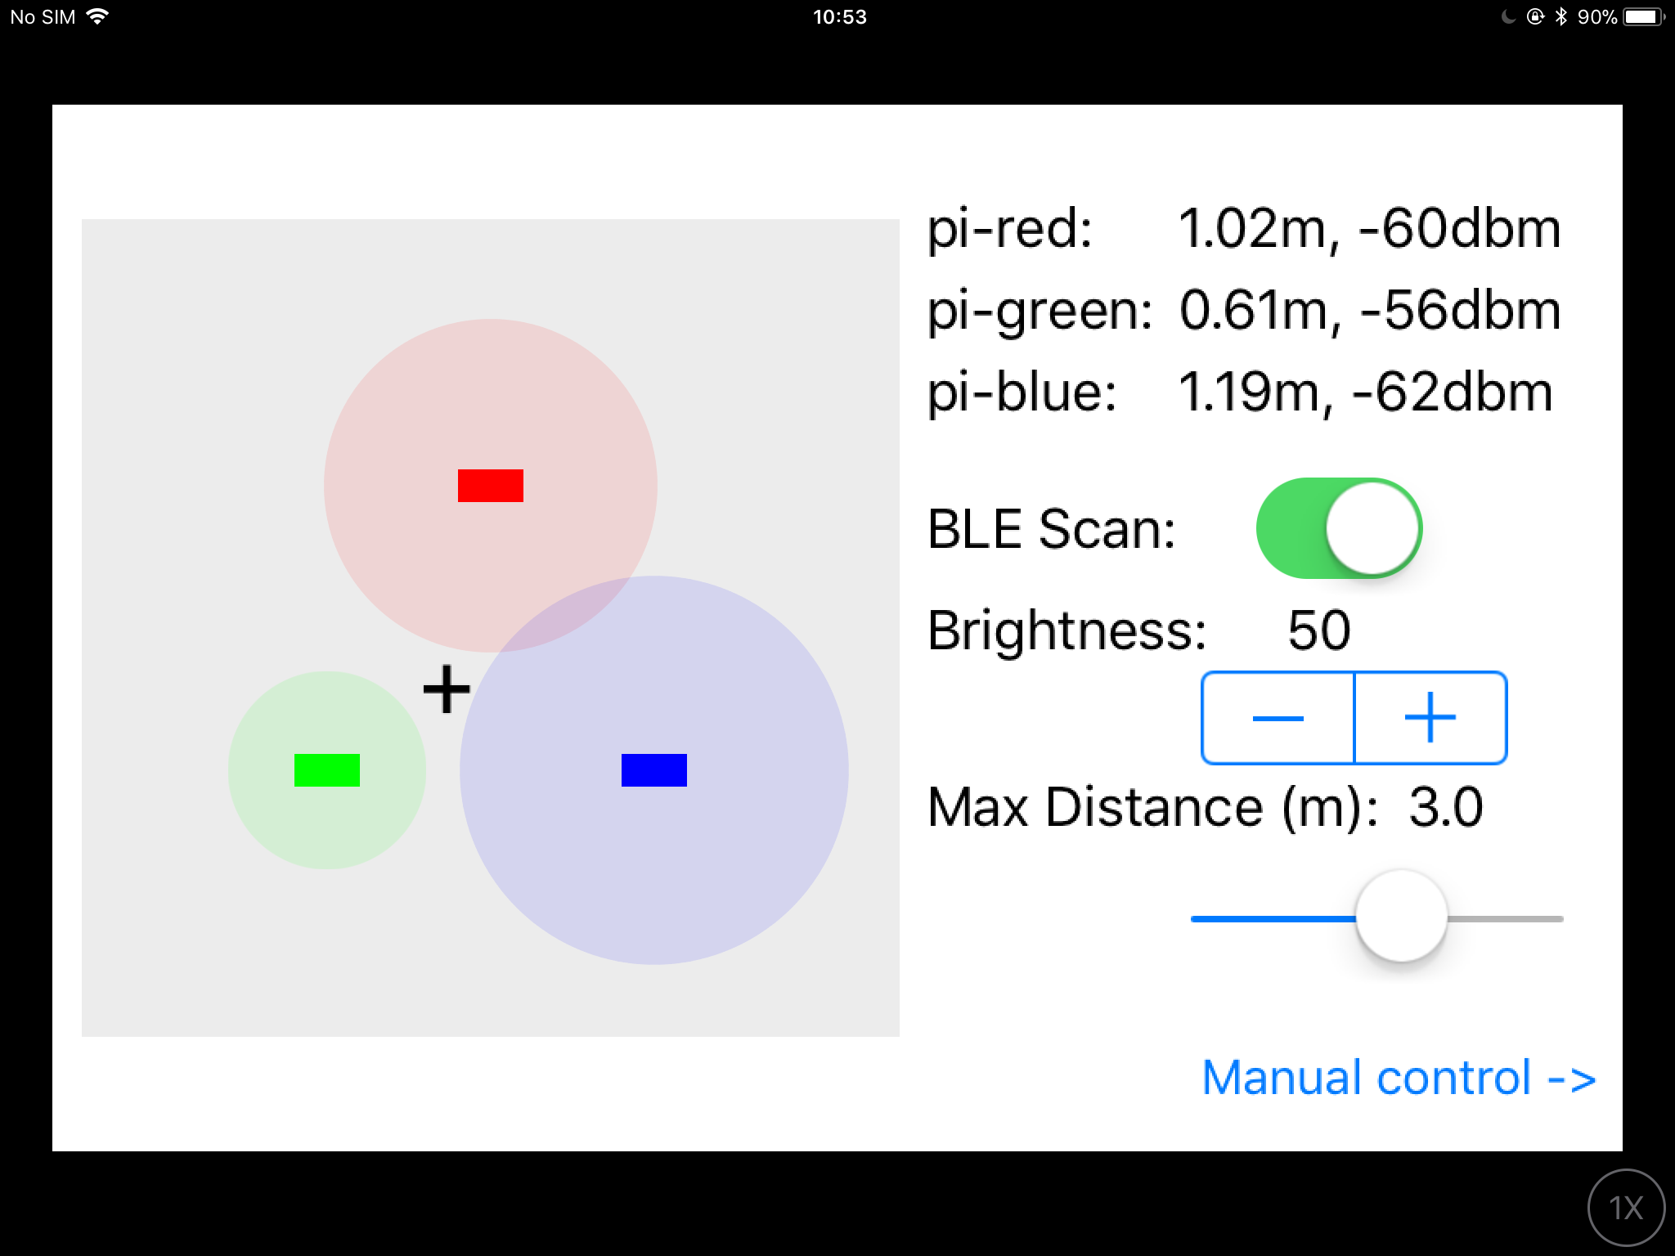
BLE Localiser (Full)
iOS Dev Scout (5 Dec 2017)
iOS Conf SG (19-20 Oct 2017)
By: Yeo Kheng Meng (yeokm1@gmail.com)
https://github.com/yeokm1/ble-localiser

Slide 2
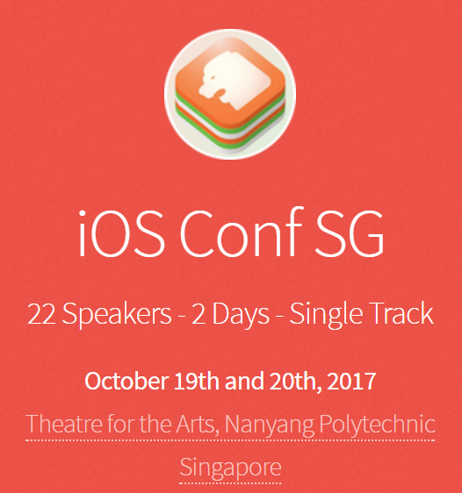
iOSConfSG 2017

Slide 3
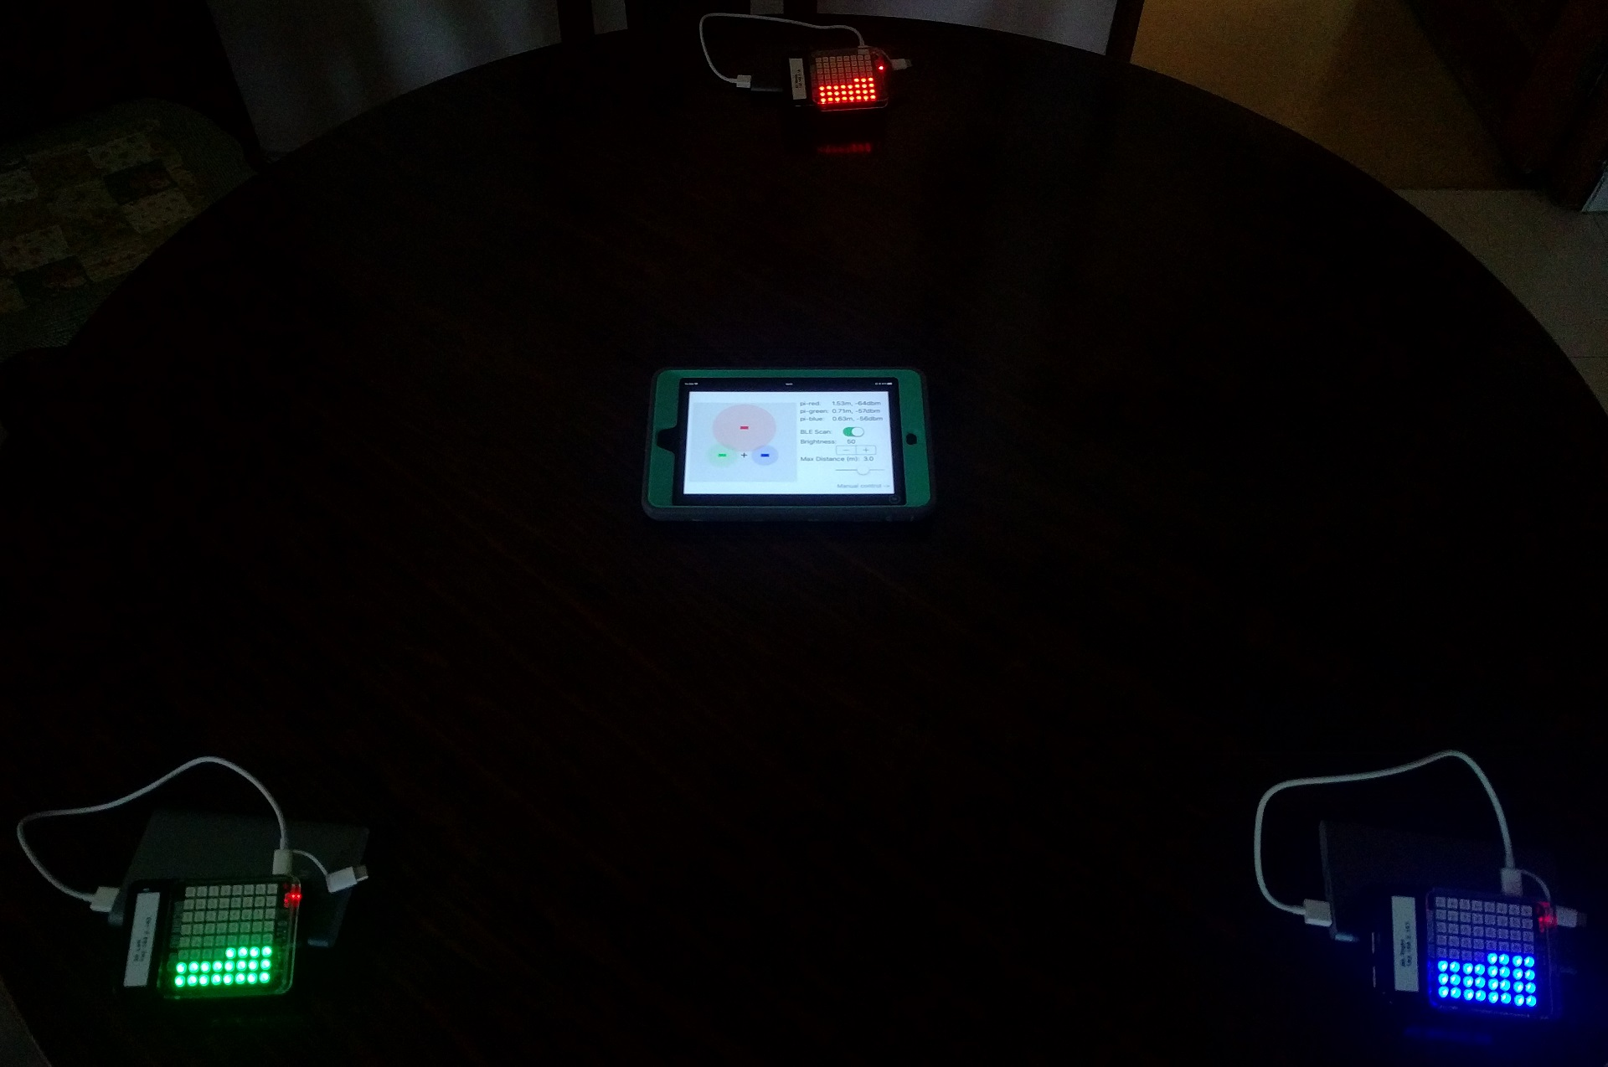
Demo
BLE Localisation
As distance ↓, LEDS ↑
Manual Control

Slide 4
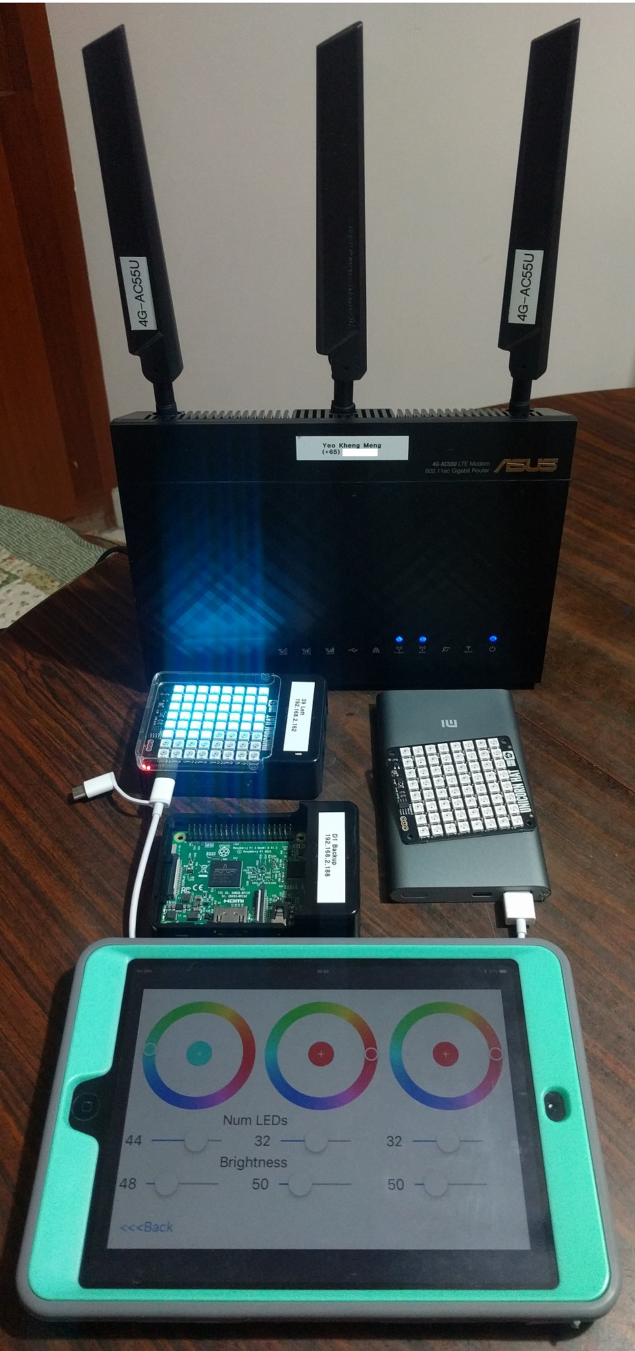
The hardware
Raspberry Pi 3
Wifi, Bluetooth (LE)
Raspbian OS
Pimoroni Unicorn Hat
8 x 8 RGB LEDs
Python Library provided by manufacturer
iPad Mini 2 + Swift App
Supporting Gear
Asus 4G-AC55U Wifi Router
3x Tripod
3x Xiaomi 10000mAh Power Bank

Slide 5
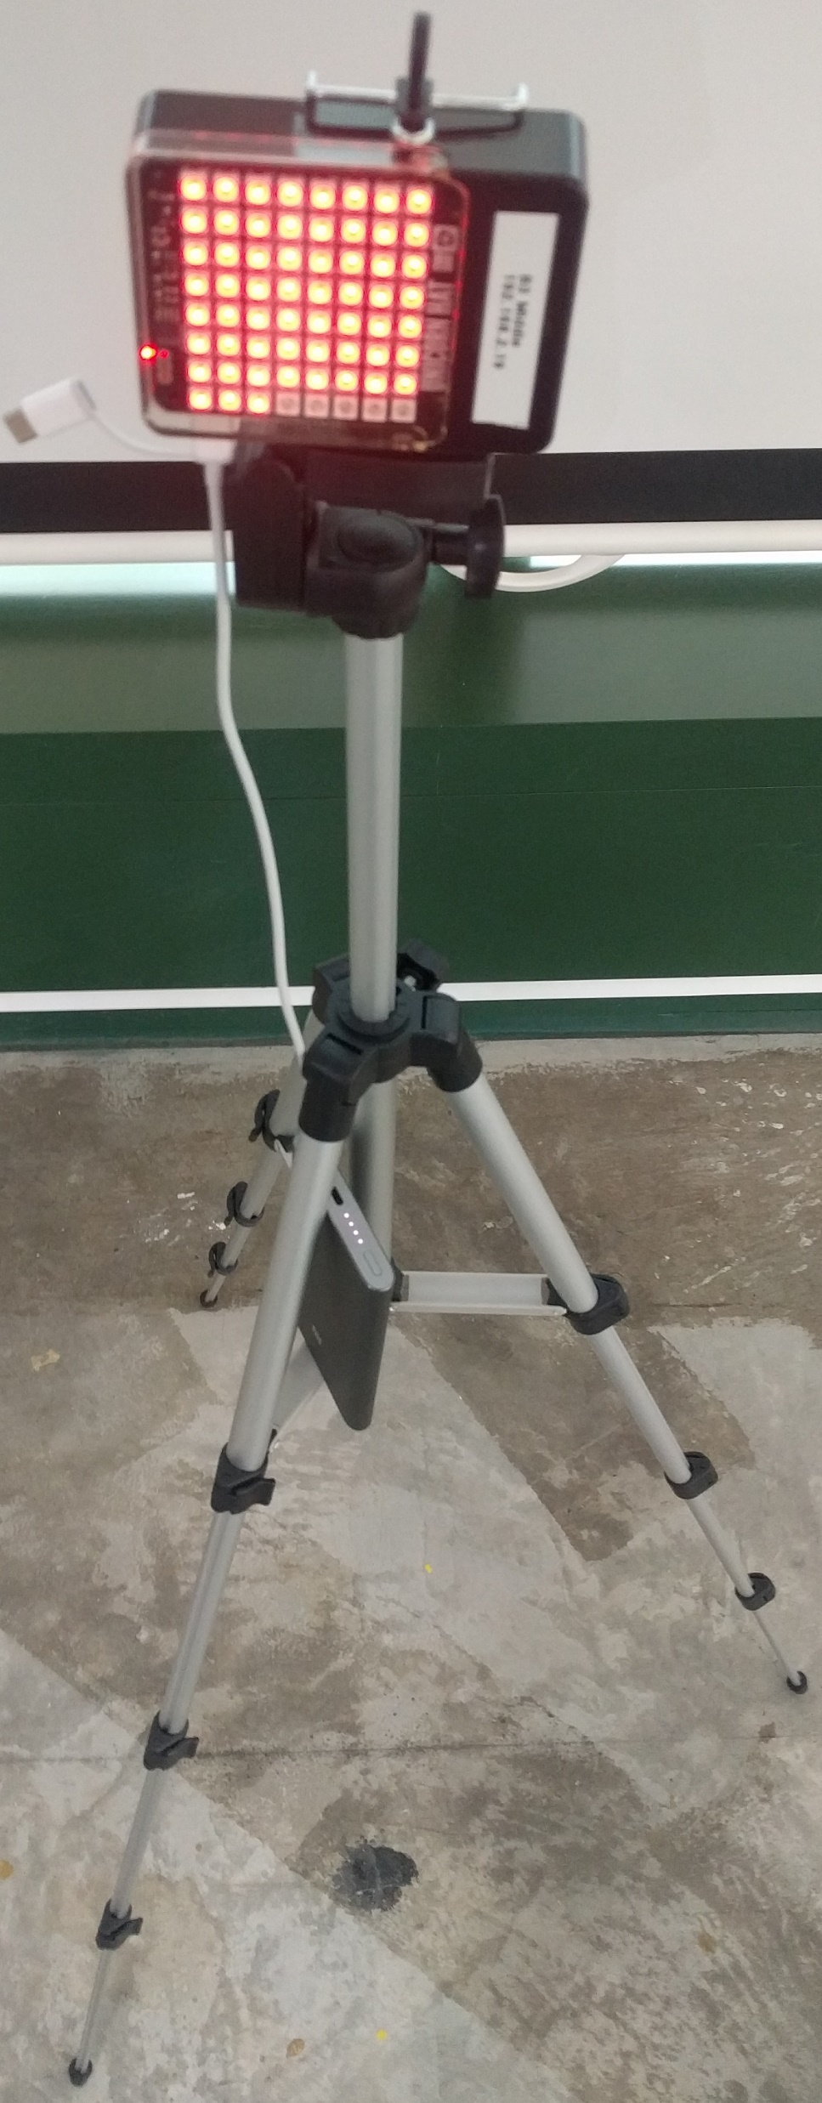
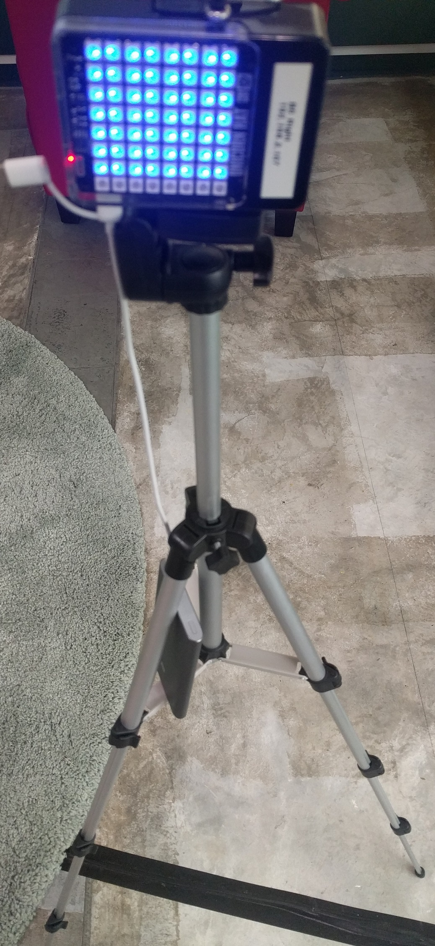
Layout
2m
2m
2m

Slide 6
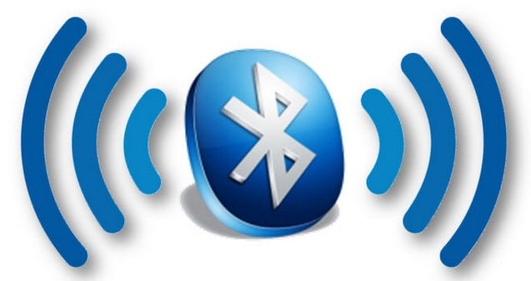
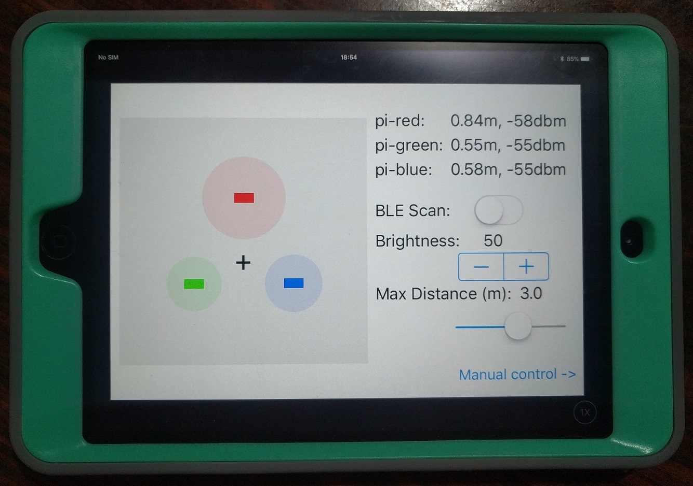

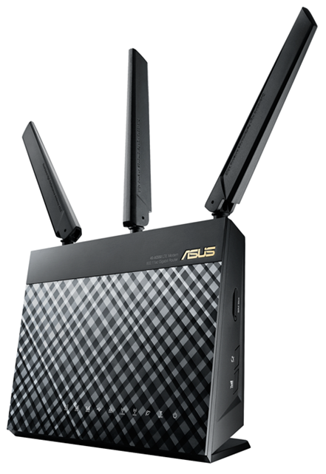
System overview
Advertisement Packets
x LEDs + colour

Slide 7
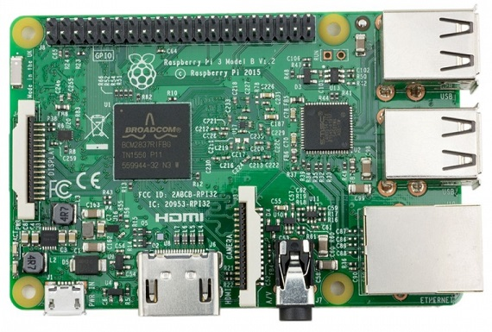
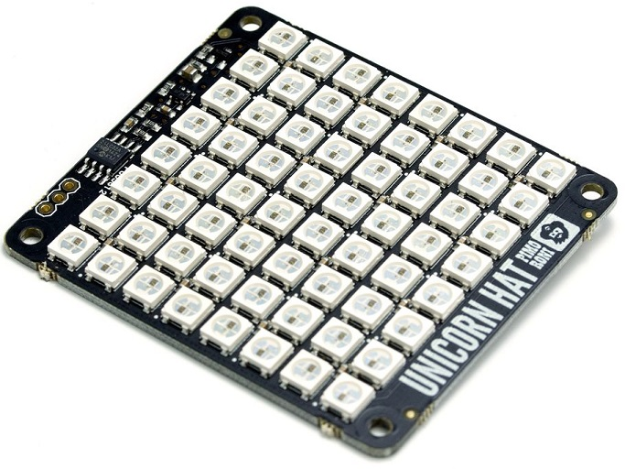


Workflow
Receive signal strength of advertisement packets
Unicorn Library
n x RGB (255, 255, 255)
Unix Domain Socket
Calculate and send LED information
via UDP
n x RGB (255, 255, 255)
Listening UDP Socket
Listening Unix Domain Socket

Slide 8
Initial OS Selection challenges
Swift Compiler on RPi (Before Sept 2017)
Only runs on Ubuntu
Unicorn library on RPi
Only runs on Raspbian
Unicorn Library
 | Ubuntu | Raspbian
Swift Compiler | ✓ | X
Unicorn library | X | ✓
Unix Domain Socket
Listening UDP Socket
Listening Unix Domain Socket

Slide 9
Let’s think outside the box

Slide 10
Cross compile ARM Swift apps on your Mac
Supports only up to Swift 3.0.2
Build the Swift Package Manager that supports Swift 3.0.2
Checkout the 30 April 2017 commit:
git clone https://github.com/apple/swift-package-manager.git
git checkout 09a6bf19b4e31d9348d98efd9db09298da152315
Look out for libraries that require system header directory
Eg. https://github.com/PureSwift/CSwiftBluetoothLinux
/usr/include/…
Go to Recovery mode to disable System Integrity Protection (SIP)

Slide 11
Swift on RPi (today)
Raspbian now supported together with Ubuntu
Swift 3.1.1 with Swift Package Manager for Raspbian
September 2017
https://www.uraimo.com/2017/09/06/A-small-update-on-Swift-for-raspberry-pi-zero-1-2-3/
sudo apt install libpython2.7 clang

Slide 12
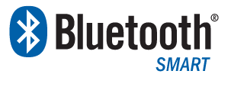
Quick Refresher on Bluetooth Low Energy (BLE)
Introduced in Bluetooth 4.0 specification (2010)
Also known as Bluetooth SMART
Traditional Bluetooth Classic
Higher Speed applications: Audio, networking
Needs MFI (Made for iPod/iPhone/iPad) certification
Target applications
Wireless battery-powered sensors eg. heart rate, thermometer, fitness
Location tracking and information serving eg. iBeacons

Slide 13
Bluetooth Broadcasting on RPi
CoreBluetooth
Use external library https://github.com/PureSwift/BluetoothLinux

Slide 14
Limitations on iOS CoreBluetooth
No official API to get Mac Address of advertising packet
Random UUID assigned to every new device
Cannot easily identify the RPis across multiple iOS devices

Slide 15
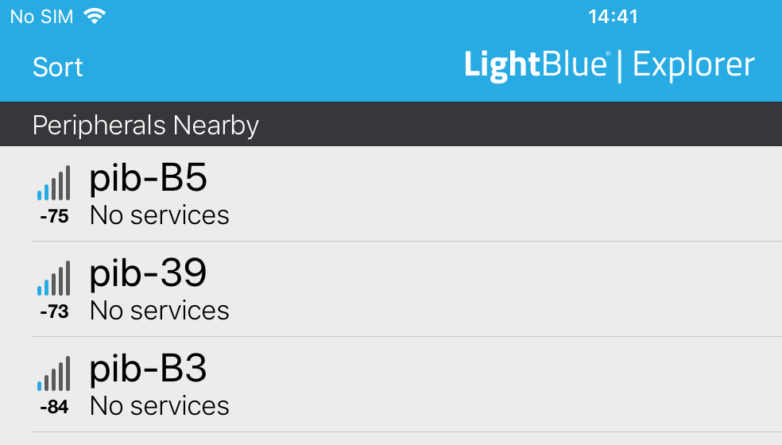
To solve the identification problem
RPi embeds unique ID into Bluetooth device name
Linux commands to run
hciconfig hci0 name “pib-xx”
hciconfig hci0 down
hciconfig hci0 up

Slide 16
iOS App
Receive signal strength of advertisement packets
Calculate and send LED information
via UDP
n x RGB (255, 255, 255)

Slide 17
Getting BLE RSSI on iOS?
Receive signal strength of advertisement packets
Received Signal Strength Indicator
BLE Scan with Duplicate keys enabled
centralManager.scanForPeripherals(withServices: nil, options: [CBCentralManagerScanOptionAllowDuplicatesKey : true])
Get Relative Signal Strength Indication (RSSI) in dBm
CBCentralDelegate
func centralManager(_ central: CBCentralManager, didDiscover peripheral: CBPeripheral, advertisementData: [String : Any], rssi: NSNumber)

Slide 18
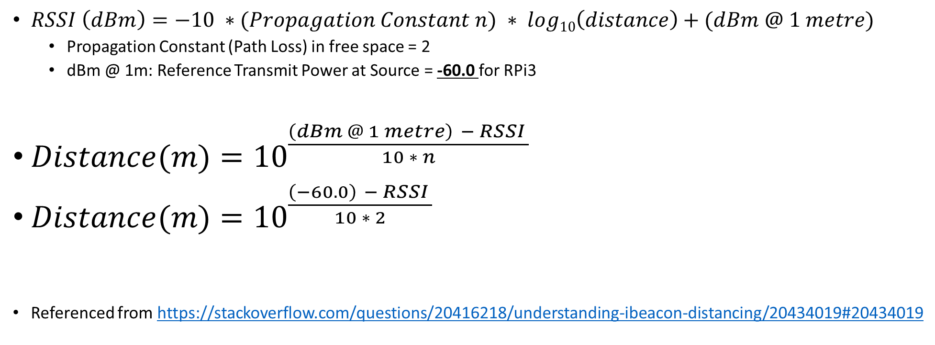
Distance(m) <-> RSSI formula
$RSSI \left(dBm\right)=−10 ∗(Propagation Constant n) ∗ log10\left(distance\right)+(dBm @ 1 metre)$
Propagation Constant (Path Loss) in free space = 2
dBm @ 1m: Reference Transmit Power at Source = -60.0 for RPi3
$Distance(m)={10}^{\frac{\left(dBm @ 1 metre\right) − RSSI }{10 ∗ n}}$
$Distance(m)={10}^{\frac{\left(−60.0\right) − RSSI }{10 ∗ 2}}$
Referenced from https://stackoverflow.com/questions/20416218/understanding-ibeacon-distancing/20434019#20434019

Slide 19
But RSSI values fluctuate widely…

Slide 20
Lets try averaging the last few values?
Implement a fixed queue
Average of values -> 1.8m
Oldest |  |  |  |  |  |  |  |  | Newest
1.1 | 5.0 | 1.4 | 1.2 | 0.1 | 1.6 | 0.2 | 1.5 | 1.8 | 4.9

Slide 21
Do a Trimmed Mean
Trim outlier values from a set
Obtain values in a fixed queue
Sort the values
Remove the 20% outliers and average the rest -> 1.43m
Oldest |  |  |  |  |  |  |  |  | Newest
1.1 | 5.0 | 1.4 | 1.2 | 0.1 | 1.6 | 0.2 | 1.5 | 1.8 | 4.9
Smallest |  |  |  |  |  |  |  |  | Largest
0.1 | 0.2 | 1.1 | 1.2 | 1.4 | 1.5 | 1.6 | 1.8 | 4.9 | 5.0
Smallest |  |  |  |  |  |  |  |  | Largest
 |  | 1.1 | 1.2 | 1.4 | 1.5 | 1.6 | 1.8

Slide 22
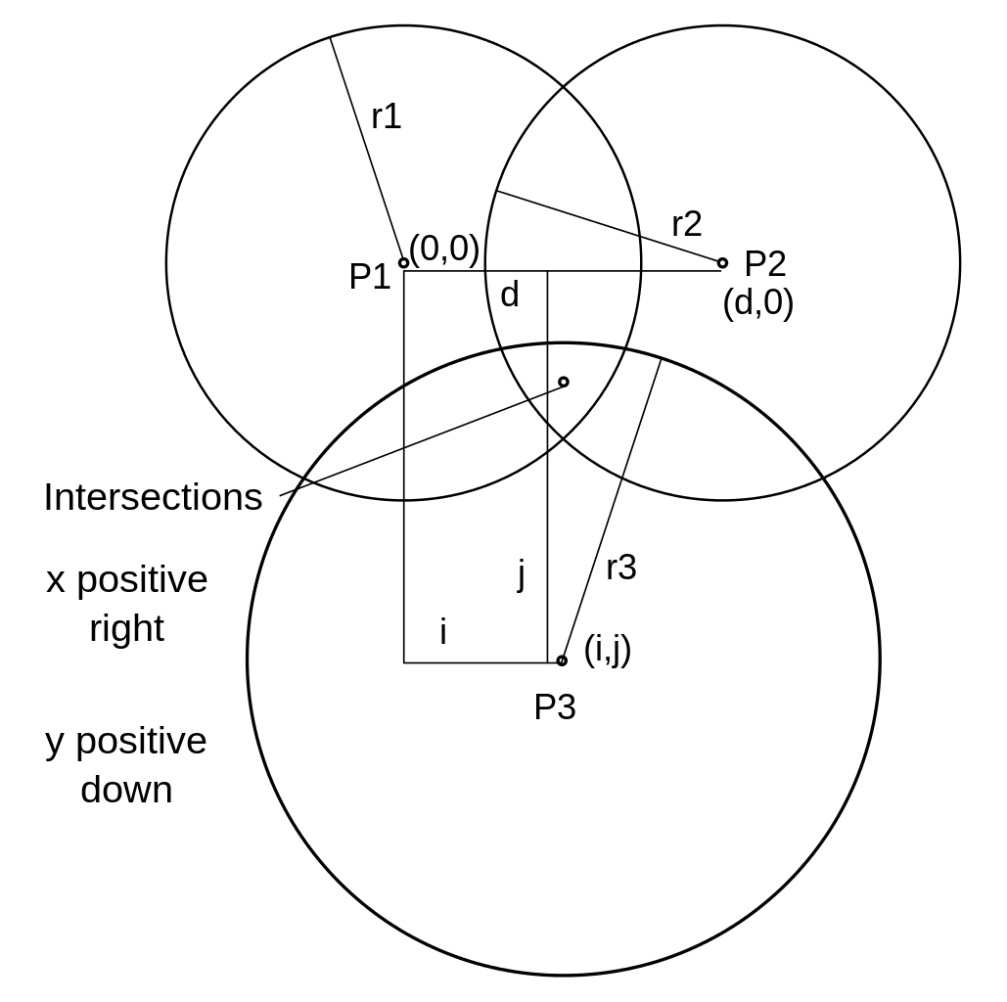
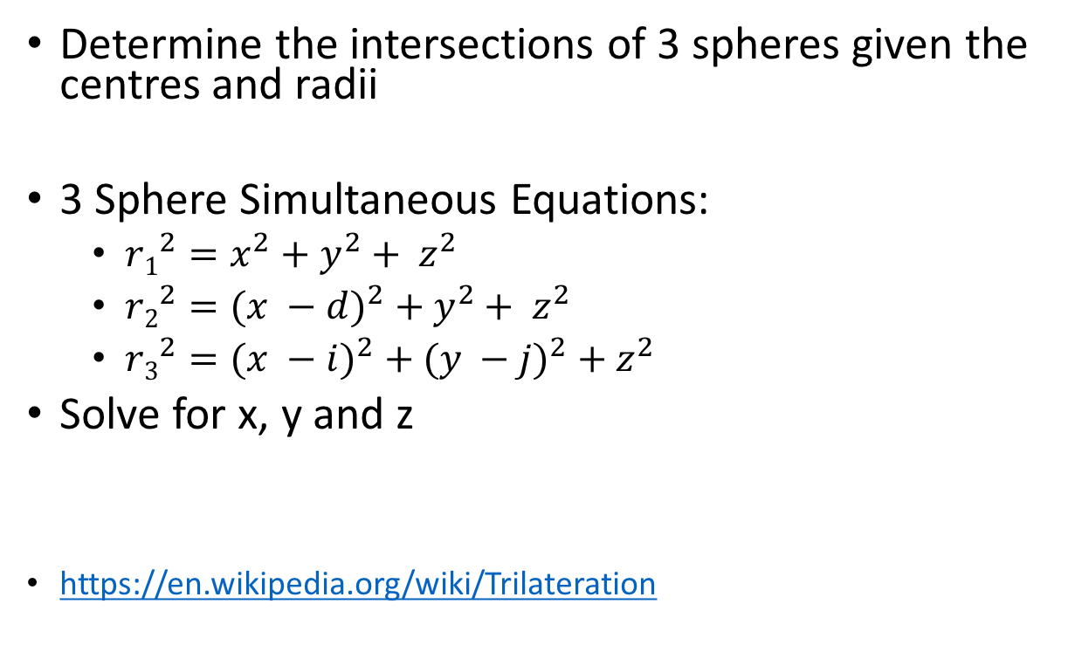
Trilateration of 3 beacon distances
Determine the intersections of 3 spheres given the centres and radii
3 Sphere Simultaneous Equations:
$r1^{2}=x^{2}+y^{2}+ z^{2}$
$r2^{2}={(x −d)}^{2} + y^{2}+ z^{2}$
$r3^{2}={(x −i)}^{2} + {(y −j)}^{2} + z^{2}$
Solve for x, y and z
https://en.wikipedia.org/wiki/Trilateration

Slide 23
Drawing the UI
Using a master UIView
Circles diameter indicates distance to beacon
Positioning everything relative to center of UIView for ease of calculation

Slide 24
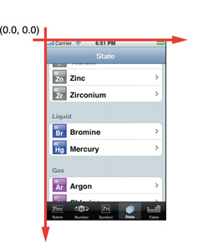
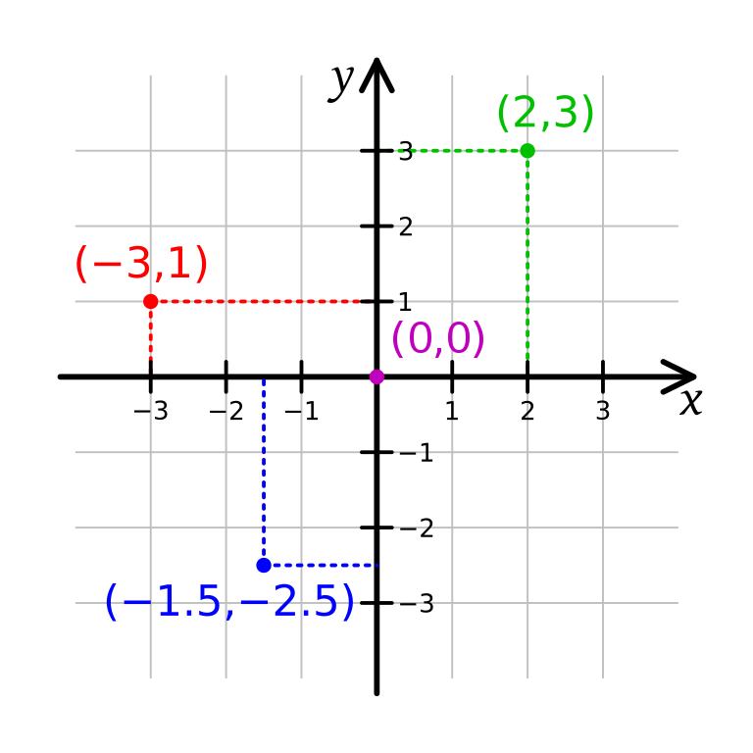
iOS Coordinate vs Cartesian Coordinate
Y-positive
X-positive
X-positive
Y-positive

Slide 25
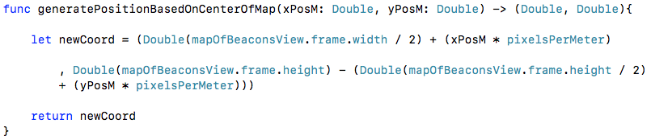
Remap the Cartesian (meters) -> iOS Coordinate
Convert meters to pixels
50 pixels / meter
Convert Cartesian -> iOS
X: Add half-width to compensate origin on left
Y: Add half-width, invert the axis

Slide 26
Sending and Receiving UDP
Why UDP frames?
Fire and forget packets
Use IBM BlueSocket library
https://github.com/IBM-Swift/BlueSocket
Works on iOS, MacOS, Linux
What iOS app sends
number of LEDs + RGB colour values (255, 255, 255)
Calculate and send LED information
via UDP
n x RGB (255, 255, 255)
Listening UDP Socket

Slide 27
Swift -> Python
App to app transfer
Network ports?
How about something more specialised?
Unix Domain Socket
Listening UDP Socket
Listening Unix Domain Socket

Slide 28
What are Unix Domain Sockets?
A form of inter-process streaming communication
Properties
Reliable
Sequential
Secure
Uses a file path eg. /home/user/socket.sock
Write/Receive bytes from the file path
File path can be secured by Unix permissions

Slide 29
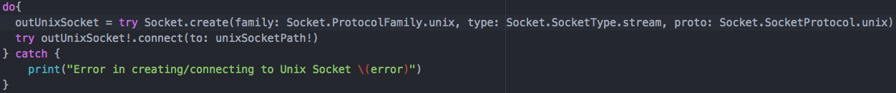
Unix domain socket send
Use IBM BlueSocket library again
https://github.com/IBM-Swift/BlueSocket
Unix Domain Socket

Slide 30
Unix domain socket receive (Python)
import socket
sock = socket.socket(socket.AF_UNIX, socket.SOCK_STREAM)
sock.bind(”socket.sock”)
sock.listen(1)
connection, client_address = sock.accept()
data = connection.recv(64)
Unix Domain Socket
Listening Unix Domain Socket

Slide 31
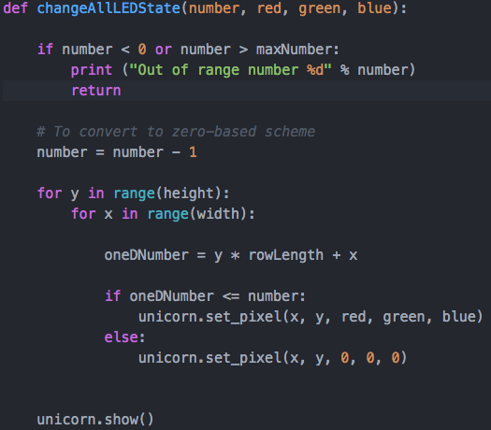
Turn on required LEDS
Unicorn Library
Listening Unix Domain Socket
Use Unicorn library to control LEDs
Iterate through all LEDs in row-major style
Turn on LED if (x * y) < (number to turn on)

Slide 32
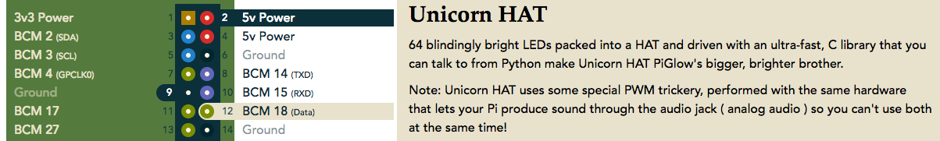
RPi -> Unicorn Hat
Uses 5V Power, GND, PWM
Pulse Width Modulation (PWM)
BCM18/PWM0
https://pinout.xyz/pinout/unicorn_hat
Unicorn Library
n x RGB (255, 255, 255)

Slide 33
Final thoughts
Greater appreciation of localization technologies
Combined many tech concepts
BLE, Swift on iOS, Swift on RPi, Python, UDP, Unix Sockets, Hardware
Finally given the talk I wanted to give at iOSConf!!!
iOS Dev Scout (5 Dec 2017)
iOS Conf SG (19-20 Oct 2017)
By: Yeo Kheng Meng (yeokm1@gmail.com)
https://github.com/yeokm1/ble-localiser

